Slide 1

MGT101
Project Management
Name : Saleh Ahmad Alheeh
ID : 201614721

Slide 2
Outline
1-introduction
2-Project Management Methodologies
3-PROJECT MANAGER COMPETENCI
5-Why do projects fail?
Successful and failed projects -4

Slide 3
1-introdiction
Project management :
the practice of initiating, planning, executing, controlling, and closing the work of a team to achieve specific goals and meet specific success criteria at the specified time.

Slide 4
2-Some Project Management Methodologies
Agile
Scrum
is one of the agile methodologies designed to guide teams in the iterative and incremental delivery of a product.
It involves working in smaller chunks, or sprints, that allow projects to pivot when needed.
Waterfall
This style involves working in waves, with each step being heavily dependent on the one before it.

Slide 5
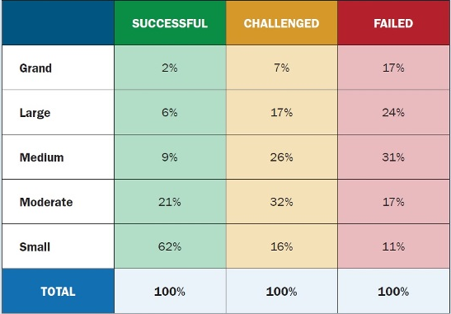
-4Successful and failed projects

Slide 6
Why do projects fail?
Weak planning
Miscommunication
Weak Business Case
requirements are not met

Slide 7
PROJECT MANAGER COMPETENCIES
Leading
Planning
Organizing
Communications
Risk Management

Slide 8

THANK YOU

